Slide 1

Holy Guacamole!
Avocado, the green gold of the world.
NICHOLAS CHATJAVAL
MICHAEL DUNNE
RAMANA KUMAR GANESULA
HIU LAI
WEI WEN TAN

Slide 2
Theme/ Inspiration / Data Topics
Average Unit Price
Exported from, to the U.S.
Avocados
Total Volume
Total Sales

Slide 3
Software Used
API Flask
Web Design and CSS
Software
Leaflet
Other JS libraries
D3

Slide 4
Website Approach
Individual index.html’s for each topic
Bootstraps, Navbars and Dropdowns
Website Design
Designing with CSS
Interactivity within the graphs like D3

Slide 5
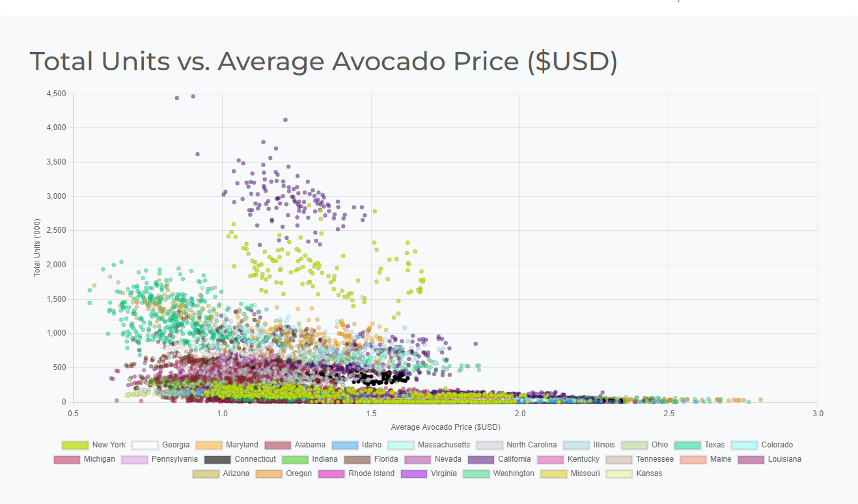
Final Visualisation (1) Units vs. Price

Slide 6
Average Unit Price
Trends of Datasets:
Southern States (eg: Georgia, Texas) generally had higher total units exported, and lower average prices.
Northern states generally had lower total units, (Massachusetts, Illinois), and higher average prices (Freight costs)
Higher populated states had higher units exported (eg: Texas)
Software Used:
d3, json
Limitations:
Cannot verify what time of year Avocados are the most expensive based on the graph
Limited data supplied for New York state, most populated of 50 states.
Too many data points.

Slide 7
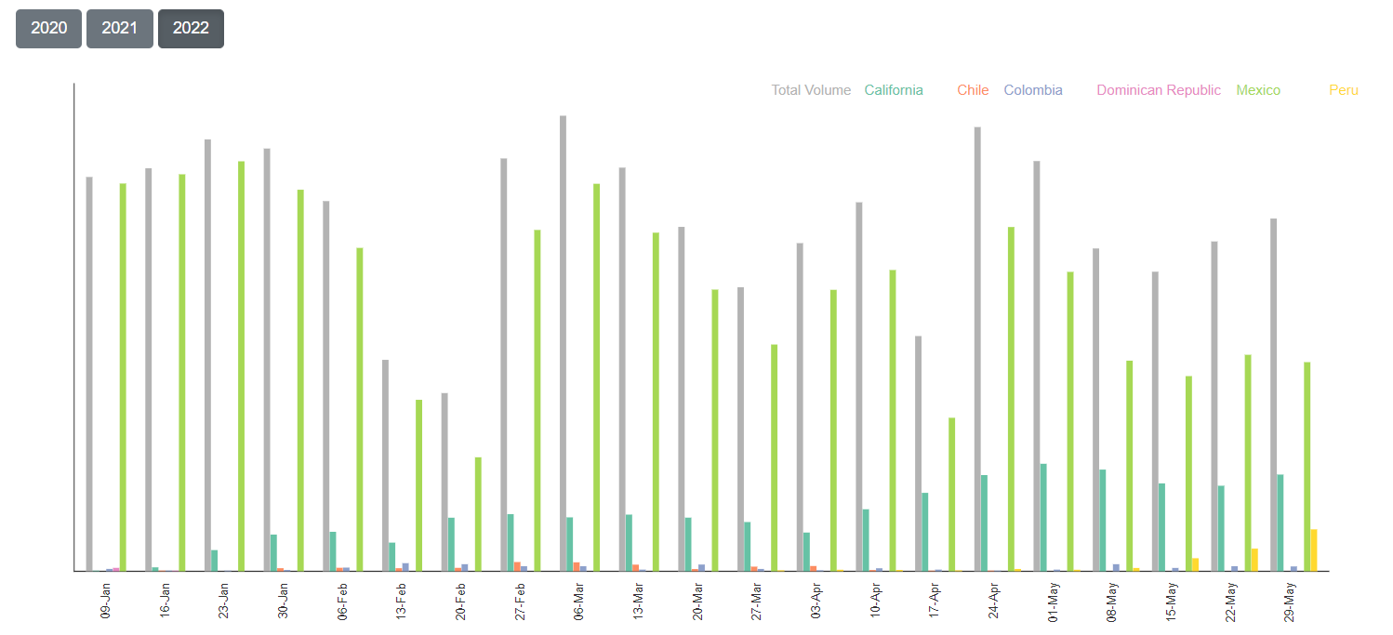
Final Visualisation (2) Total Volume

Slide 8
Total Volume
Trends of Datasets:
Mexico has the highest volume of avocado through the 2-and-a-half year period.
California has a higher volume of avocados at the middle of the years 2020 and 2021, but none in 2022.
Three different countries (Chile, Peru, Dominican Republic) have a volume of avocados only a certain period of time (plenty of zeros).
Software Used:
D3, json, MongoDB
Limitations:
A small number of countries available - indicating issues in details on the global situation of the volume of avocados.
There is some difficulty in finding data from a variety of countries.

Slide 9
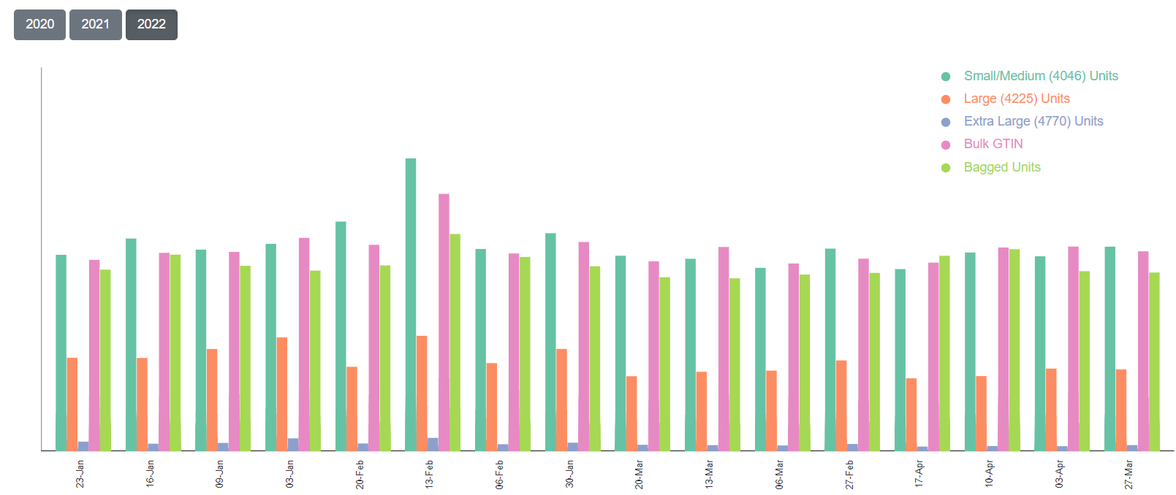
Final Visualisation (3) Total Sales

Slide 10
Total Sales
Trends of Datasets:
The majority of sales come from small/medium and bulk GTIN units.
There is a seasonal trend (upward/downward wave movements) - there are less sales in the second half of the 2021 year.
Noticeable spikes in February.
Software Used:
D3, json, MongoDB
Limitations:
Lack of detail on the small/medium units in a much bigger depth (they are combined), making it harder to understand the difference.
This only focuses on hass avocados, may not provide a bigger picture on the variety of different avocados.
There is also a lack of clarity on the pricing.

Slide 11
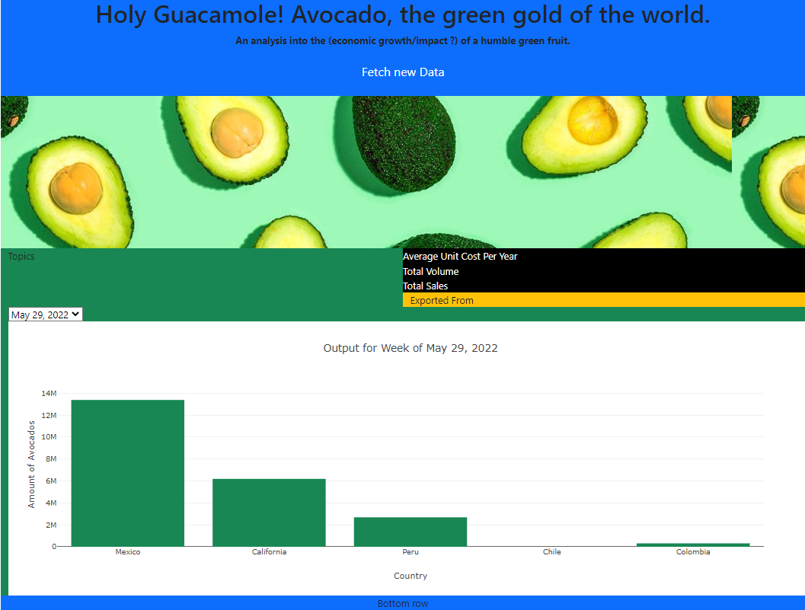
Final Visualisation (4) Exported From

Slide 12
Where They’re Exported From
Trends of Datasets:
Data heavily skewed towards Mexico & California in early 2020. Roughly 98% of all Avocados exported.
Progressively becoming
South American countries exporting significantly more Hass Avocados, than Organic. 99:1 ratio most dates.
90:10 in California
Software Used:
d3. json, Plotly, DROPDOWN , MongoDB
Limitations:
Disproportionate dataset.
Given the small number of countries, decided to go with a Plotly bar graph over Leaflet.
Mexico often consisted of 70-80% of total amount of Avocados. California: 15-20% From 124 weekly dropdown bar graphs.
Dataset only lists whether the Avocados are Organic or Hass varieties More than 500+ confirmed types of Avocados.

Slide 13

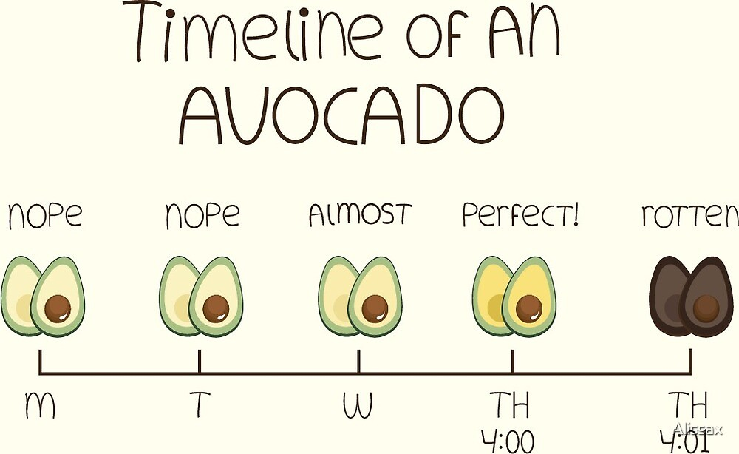
That’s the end!!
Thank you for listening

